Slide 1
Electric Current

Slide 2
Bell Ringer
What is another term for potential electrical difference?
What is the definition of electrical current?

Slide 3
Circuits
Closed Circuit
  Allows a complete path for electrons to travel
Open Circuit
  Does not allow a complete path for the electrons to travel

Slide 4
Flow of Charge
Potential Difference: When the ends of an electric conductor are at different electric potentials (voltages)
Charge continues to flow until the ends of the conductor has the same voltage

Slide 5
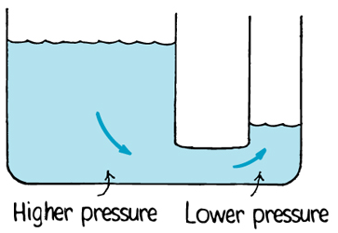
Flow of Charge

Slide 6
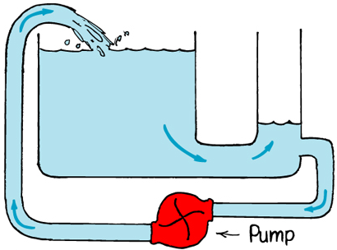
Flow of Charge

Slide 7
Electric Current
Electric Current: The flow of electric charge
  The loosely bound outer electrons of conductors carry the charge through circuits
  Protons tightly bound to the nuclei of atoms

Slide 8
Electric Current
current = charge / time
or
I = q/t
Units: Amps (A)
  An amp is the flow of 1 C of charge per second
  NOTE: 1 C = the charge of 6,240,000,000,000,000,000 electrons

Slide 9
Electric Current
Usually the number of electrons entering a wire is the same as the number leaving
  This gives the wire a net charge of zero

Slide 10
Voltage Sources
Voltage Source: A device which provides a potential difference in order to keep current flowing
  Dry/Wet Cells: Convert chemical energy to electrical energy
  Generators: Convert mechanical energy to electrical energy
The voltage available to electrons moving between terminals is called electromotive force, or emf.

Slide 11
Voltage Sources
Note:
  Voltage flows across a circuit
  Current flows through a circuit

Slide 12
Bell Ringer
Which object yielded the highest potential difference?
Which arrangement yielded the most potential difference?
What are two types of voltage sources?

Slide 13
Current vs. Voltage
Current – Flow rate
  Measured in Amperes
  Amount of flowing water
Voltage – Potential
  Measured in Volts
  Water Pressure

